Slide 1
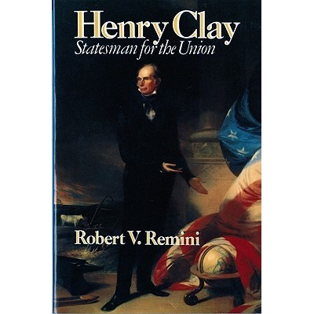
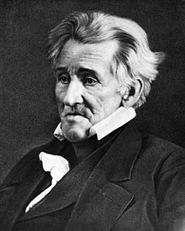
Period 4 : The Nullification Crisis
When I was close to death, I was asked if I had left anything undone. “Yes, I didn’t shoot Henry Clay, and I didn’t hang John C. Calhoun.”
Everything You Need to Know About The Nullification Crisis To Succeed In APUSH

Slide 2
Tariffs: A Brief Review
What is a tariff?
Tax on foreign goods
Raises the price of foreign made products
In theory, this will benefit American industries as foreign products now cost more
Who would favor tariffs?
The North - industry
Who would be against tariffs?
South (and West) – little industry, consumers

Slide 3
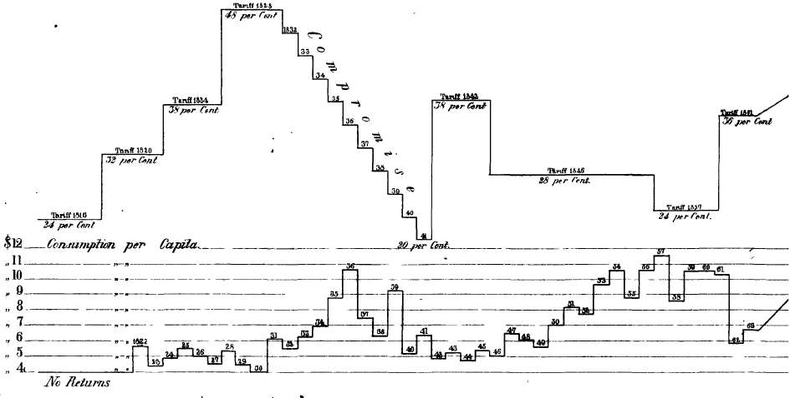
Tariff of 1828 (Abominations)
Passed in 1828 in hopes to hurt President Adams
Raised tariff rates significantly
Favored Northern industries, hurt Southerners
Southerners received no tariff protection for their goods

Slide 4
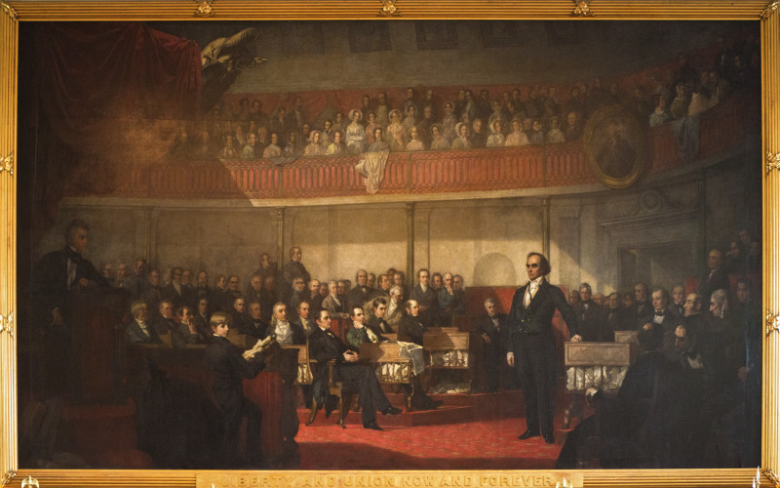
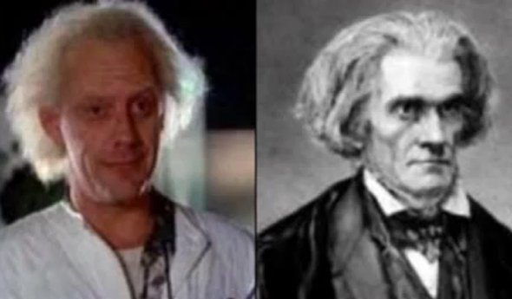
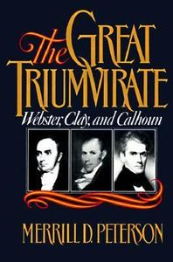
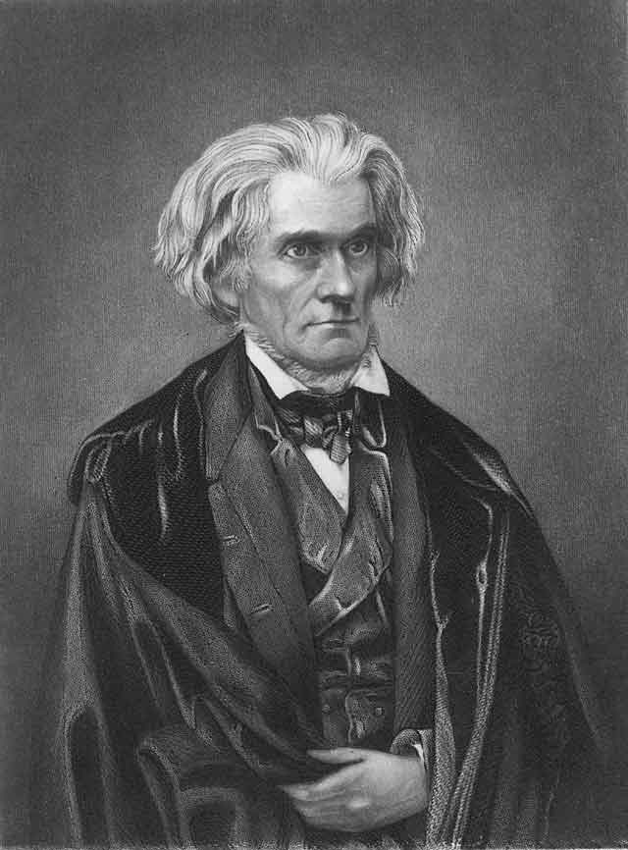
John C. Calhoun
Who was he?
Part of “Great Triumvirate”
VP under Adams and Jackson
Senator from SC
The South Carolina Exposition
Written anonymously by Calhoun
Drew inspiration from VA and KY Resolutions
Encouraged states to nullify the Tariff of Abominations
Webster-Hayne Debate (1830):
Daniel Webster supported the union and was critical of cries of secession

Slide 5
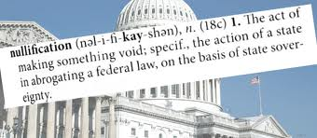
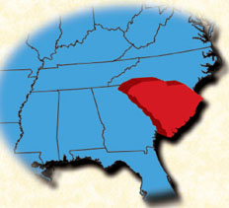
Tariff of 1832
Lowered rates from the Tariff of Abominations
However, the South felt they were still too high
SC calls a state convention
Officially nullified the Tariff of 1832
SC also threatened secession if DC collected tariffs by force

Slide 6
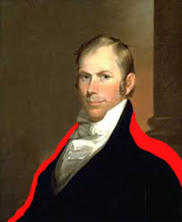
A Hero Is Needed…….
The “Great Compromiser’s” 2nd Compromise
Compromise Tariff of 1833
Over the next 8 years, the tariff rates would fall by 10% per year
South favored
Force Bill:
Passed the same day as Tariff of 1833
The President could use the military to collect tariffs if necessary
Both Jackson and Calhoun saved face
The crisis is averted

Slide 7



Thanks for watching!
Subscribe to my channel
Help spread the word
Questions? Comments? Ideas for videos?
Leave in comments
I still have one more major compromise left…..
Subscribe
Down here!

